Slide 1
Classifying Climate Change Attitudes with Twitter
Group 7
Félicie Bizeul, Eleftheria Tetoula Tsonga, Mathieu Grasland, Iason Tsardanidis, Anil Keshwani

Slide 2
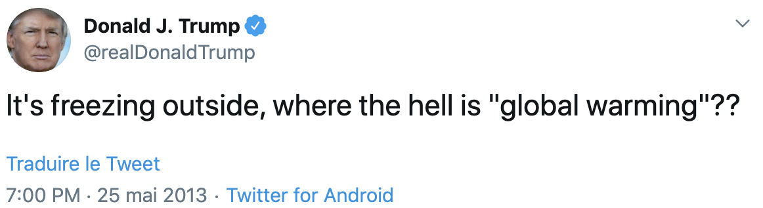
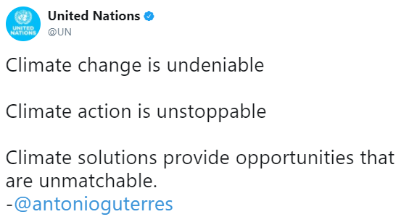
Our Goal
Climate Change Denial
Denial, dismissal, or unwarranted doubt that contradicts the scientific consensus on climate change, including the extent to which it is caused by humans, its effects on nature and human society, or the potential of adaptation to global warming by human actions
The global warming controversy concerns the public debate over whether global warming is occurring, how much has occurred in modern times, what has caused it, what its effects will be, whether any action can or should be taken to curb it, and if so what that action should be
Our goal was to come up with an algorithm that classifies a tweet referring to climate change as denier’s tweet or a believer’s tweet
To do that we identified specific twitter accounts present on the climate change discussion with a clear point of view in the subject: denier vs. believer

Slide 3
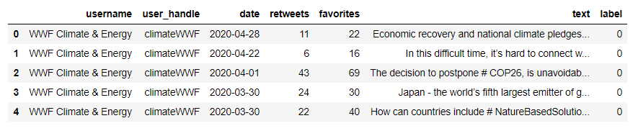
Data Collection
Once we came up with a list of account handles we began collecting the data
Since, Twitter’s API doesn’t allow the retrieval of tweets past 7 days old, we used a command line scraping script* that allowed us to do that
As an example of the command we used is:
python main.py --username “GretaThunberg” --query “climate change” --since 2018-12-01 --until 2020-07-28 --max-tweets 1000
Filtered tweets to obtain only those concerning climate change - filter for tweets containing the string “climate”
We obtained a balanced dataset of approximately 10k tweets per class.
Tweets labelled manually according to tweet account (username / handle)
* https://github.com/PJHRobles/Twitter-Get-Old-Tweets-Scraper

Slide 4
Data Preprocessing I: Data Cleaning
Basic preprocessing of our corpus of textual tweets was necessary.
Removal of URLs, extraneous whitespace, punctuation and English possessives: “[noun]’s”
Removal of stopwords - Common, ‘contentless’ function words e.g. has, was, a, or, into
Cleaning of Twitter mentions to usernames
Stemming (via Porter’s Algorithm) - Consolidation of inflected word forms into stems
Expansion of Twitter abbreviations and slang into regular speech
Expansion of emoji into textual emoji shortcodes
We implemented the above steps in the form of a scikit-learn estimator class.
We applied these steps for our standard embeddings; Word2Vec does not require such cleaning.
Notes:
For reference
1. Bag of Words - $t_i \in R^V$ with elements $t_{ij} \in \{0, 1\}$
2. Frequency Bag of Words - As above but $t_{ij} \in \mathbb{N^+}$
3. Term Frequency-Inverse Document Frequency - $\dfrac{f_{t,d}}{{\sum_{t' \in d}{f_{t',d}}}} \cdot \log \frac {N} {n_t} \implies t_{ij} \in \mathbb{R^+}$
4. Pretrained Word2Vec Vectors - Constructed via a shallow neural network
where $V$ is the number of distinct tokens in the corpus

Slide 5
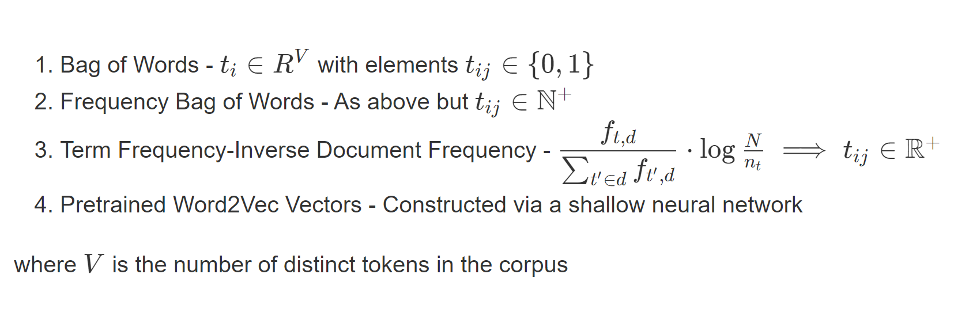
Data Preprocessing II: Word Embeddings
Notes:
For reference
1. Bag of Words - $t_i \in R^V$ with elements $t_{ij} \in \{0, 1\}$
2. Frequency Bag of Words - As above but $t_{ij} \in \mathbb{N^+}$
3. Term Frequency-Inverse Document Frequency - $\dfrac{f_{t,d}}{{\sum_{t' \in d}{f_{t',d}}}} \cdot \log \frac {N} {n_t} \implies t_{ij} \in \mathbb{R^+}$
4. Pretrained Word2Vec Vectors - Constructed via a shallow neural network
where $V$ is the number of distinct tokens in the corpus

Slide 6
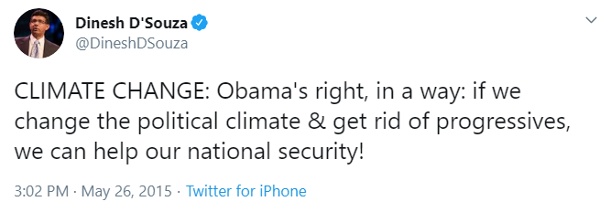
Word Embeddings Visually
climat
chang
obama
right
way
chang
polit
climat
get
rid
progress
help
nation
secur
1
0
…
0
1
…
1
0
0
…
0
1
0
…
0
1
0
…
0
1
…
2
0
…
0
1
…
1
0
0
…
0
1
0
…
0
1
0
…
0
1
…
0.18
0
…
0
0.09
…
0.51
0
0
…
0
0.45
0
…
0
0.36
0
…
0
0.45
…
BOW
FBOW
TF-IDF

Slide 7
Word2Vec - Distributional Semantics
Hidden Layer
Yields our embeddings
Input Vector
Bag-of-Words
Softmax / Multinomial Classifier
Σ
“climate”
1
0
…
0
1
…
1
0
0
…
0
1
0
…
0
1
0
…
0
1
1
…
Σ
Σ
.
.
.
.
.
.
.
.
.
.
“Obama”
“right”
Σ
Σ
Σ
Σ
Σ
Σ
Σ

Slide 8
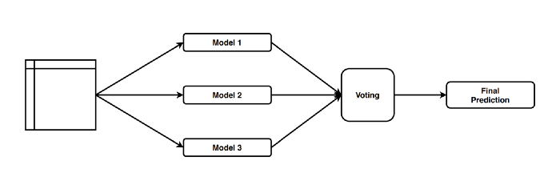
Classification Models
Logistic Regression
Random Forest
CatBoosting Algorithm
Support Vector Machine
Naive-Bayes (Gaussian)
Soft-Voting Method

Slide 9
Logistic Regression
Logistic Regression is the appropriate regression analysis to conduct when the dependent variable is binary
Logistic regression is easier to implement, interpret and very efficient to train.
Logistic regression is less prone to overfitting but it can overfit in high dimensional datasets. You should consider Regularization (L1 and L2) techniques to avoid over-fitting in these scenarios
Hyper-parameters :
penalty : [l1, l2, elasticnet] (The norm used in penalization)
solver : [liblinear, saga, lbfgs] (Algorithm used in the optimization problem)
l1_ratio : float (Only in the case of elasticnet)
multi_class : SET TO 'ovr'
max_iter : SET TO 1000
C: float (Results showed that the best one is the default one (C=1))

Slide 10
Random Forest
Random Forest is based on the bagging algorithm and uses Ensemble Learning technique. It creates as many trees on the subset of the data and combines the output of all the trees. In this way it reduces overfitting problem in decision trees and also reduces the variance and therefore improves the accuracy.
Random Forest is usually robust to outliers and can handle them automatically.
Random Forest can automatically handle missing values.
No feature scaling required
Has the power of handle large data sets with higher dimensionality
They provide a reliable feature importance estimate
The predictive performance can compete with the best supervised learning algorithms
Hyper-parameters :
n_estimators : [50, 100, 300] (The number of trees in the forest)
bootstrap : True (Whether bootstrap samples are used when building trees. If False, the whole dataset is used to build each tree)
max_depth : [80, 100, None] (The maximum depth of the tree. If None, then nodes are expanded until all leaves are pure or until all leaves contain less than min_samples_split samples)
min_samples_split : [2, 5, 10] (The minimum number of samples required to split an internal node)
min_samples_leaf : [1, 3, 5] (The minimum number of samples required to be at a leaf node)
max_features : ['sqrt', 'log2'] (The number of features to consider when looking for the best split)

Slide 11

CatBoosting Classifier
An innovative algorithm for processing categorical features. No need to preprocess features on your own — it’s performed out of the box. For data with categorical features the accuracy would be better compare to other algorithm.
The implementation of ordered boosting, a permutation-driven alternative to the classic boosting algorithm (target leakage causes prediction shifts). On small datasets, the GB is quickly overfitted. In Catboost there is a special modification for such cases acts on the basis of decision trees. That is, on those datasets where other algorithms had a problem with overfitted you won’t observe the same problem on Catboost.
Transforming categorical features to numerical features (One-Hot-Encoding)
Fast and easy to-use GPU-training. It can outperforms its predecessor with training time 8 x times faster than they do.
Other useful features: missing value support, great visualization.
references: CatBoost: unbiased boosting with categorical features (Liudmila Prokhorenkova, Gleb Gusev, Aleksandr Vorobev, Anna Veronika Dorogush, Andrey Gulin. NeurIPS, 2018 arXiv:1706.09516)
Hyper-parameters :
border_count : [100, 250, 500, 1000] (The number of splits for numerical features)
depth : randint(1, 10) (Depth of the tree)
l2_leaf_reg : float [1, 5, 10, 100] (Coefficient at the L2 regularization term of the cost function)
learning_rate : [0.001, 0.01, 0.05, 0.1, 0.2, 0.3] (The learning rate used for training)
n_estimators : [100, 250, 500, 1000] (The maximum number of trees that can be built when solving machine learning problems)

Slide 12
SVM Classifier
Choose separation hyperplane based on support vectors.
Doesn’t need much training data to start providing accurate results.
It can solve linear and non-linear problems.
It works relatively well when there is clear margin of separation between classes.
SVM is more effective in high dimensional spaces and are effective in cases where number of dimensions is greater than the number of samples
Hyper-parameters :
kernel: [linear, rbf] (Specifies the kernel type to be used in the algorithm)
C : [0.01,0.1,1,10,10,1000] (Regularization parameter. The strength of the regularization is inversely proportional to C)
gamma: [0.001, 0.001, 0.01] (Kernel coefficient for ‘rbf)

Slide 13
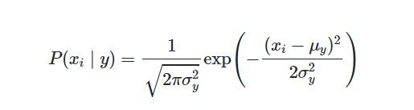
Gaussian Naive-Bayes Classifier
Is a variant of Naive Bayes that follows Gaussian normal distribution and supports continuous data
You can get really good results even when data available is not much
Bayes Theorem can be used to calculate conditional probability.
The likelihood of features is assumed to be:
Hyper-parameters :
var_smoothing : [pow(10,k)/1000000000 for k in range(10)] (Portion of the largest variance of all features that is added to variances for calculation stability)

Slide 14
Results - Summary (evaluated on test sample)
 | Cat Boosting (CB) | Gradient Boosting (GB) | Light Gradient Boosting (LGB) | Logistic Regression | Gaussian Naive Bayes (NB) | Random Forests (RF) | Support Vector Machines (SVM)
Bag-of-Words | 0.913 | 0.900 | 0.905 | 0.910 | 0.873 | 0.903 | 0.904
Bag-of-Words - Frequencies | 0.913 | 0.901 | 0.904 | 0.912 | 0.850 | 0.902 | 0.903
Bag-of-Words (bigrams) | 0.913 | 0.906 | 0.905 | 0.920 | 0.898 | 0.902 | 0.911
Term Frequency-Inverse Document Frequency (TF-IDF) | 0.906 | 0.891 | 0.900 | 0.915 | 0.849 | 0.899 | 0.909

Slide 15
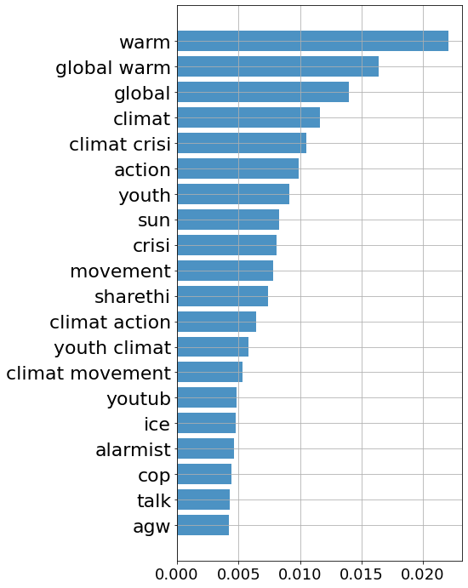
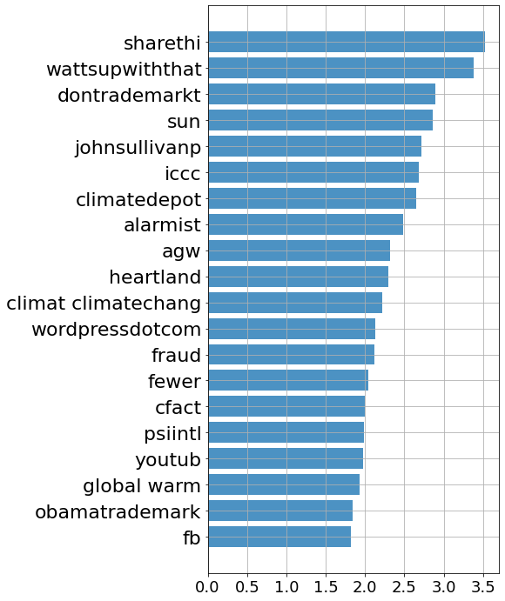
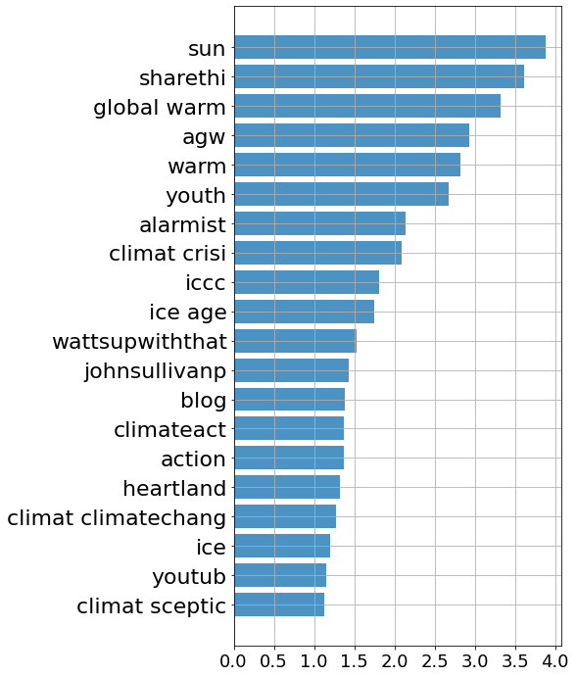
Results - Important Features for Separation
Random Forests
Logistic Regression
CatBoost

Slide 16
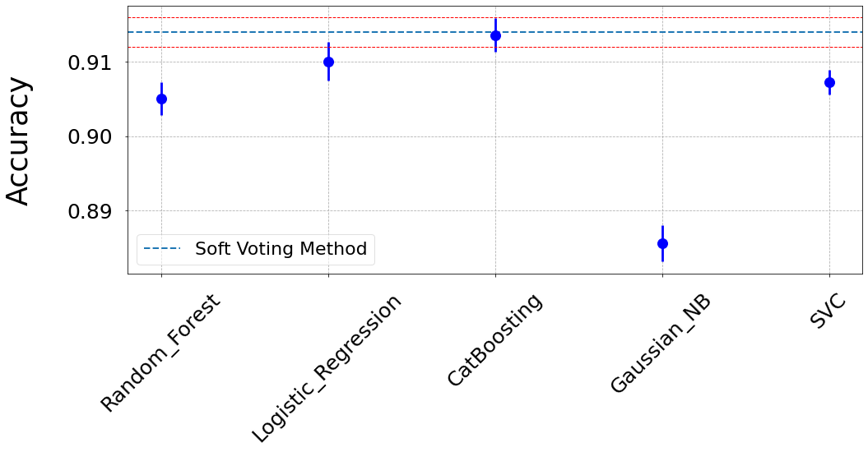
Soft-Voting Method
Taking the average of the probabilities estimated from all the classifiers
Pick only the best classifiers
Needs probabilities threshold optimization
Exclude NB classifier from final voting model
Test sample accuracy = 0.922

Slide 17
Remarks and Caveats
Classifiers used similar features for separation of attitude classes
#sharethis; climate crisis; sun; global warming; alarmist
Why Bigrams (length 2 n-grams) provided best classification accuracy unclear
Most features
Higher n for n-grams would be computationally intensive
NB and SVM should be best - We found this was not the case
Word2Vec performed poorly in trials
Accuracy 0.85 versus 0.75 with randomly populated length-300 vectors!
Possible to predict attitude without modelling language (e.g. grammar) explicitly
Improvement: Language modelling (e.g. via NN) would likely improve accuracy
Caveat: We do not account for non-independence of tweets within accounts
Caveat: Our classifier may perform poorly on accounts outside the training set
Our collection/labelling method may introduce systematic bias, but more on this in a moment...

Slide 18



Example Predictions
For Fridays4future we correctly predicted (0.11) that this account is pro climate change
For Paul Joseph Watson’s tweet (@PrisonPlanet; 0.97) we correctly predicted that this account is anti climate change
For Stephen Colbert, we misclassify this tweet (0.87) - the content of the tweet is sarcastic

Slide 19

Thank you for your attention

